Slide 1
Introduction to Numerical Solution of Ordinary Differential Equations (ODE)
Dr. Luis Sanchez

Slide 2
Contents
Review to ODEs.
Taylor series methods.

Slide 3
Fast Review of ODEs
Recall basic definitions of ODEs:
Order
Linearity
Initial conditions
Solutions of Ordinary Differential Equations.
Classify ODEs based on:
Order, linearity, and conditions.
Classify the solution methods.

Slide 4
Differential Equations
Differential
Equations
Ordinary Differential Equations
involve one or more
Ordinary derivatives of
unknown functions
Partial Differential Equations
involve one or more
partial derivatives of
unknown functions

Slide 5
Example of ODE: Model of Falling Parachutist
The velocity of a falling parachutist is given by:

Slide 6
Order of a Differential Equation
The order of an ordinary differential equation is the order of the highest order derivative.
First order ODE
Second order ODE
Second order ODE

Slide 7
Linear ODE
An ODE is linear if The unknown function and its derivatives appear to power one. No product of the unknown function and/or its derivatives
Linear ODE
Linear ODE
Non-linear ODE

Slide 8
Nonlinear ODE
An ODE is Nonlinear if the unknown function and its derivatives appear to power different of one or product of the unknown function and/or its derivatives

Slide 9
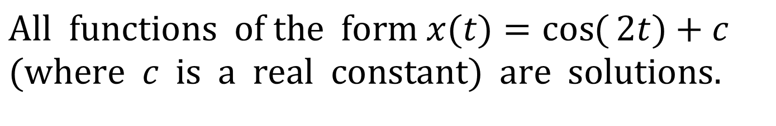
Solutions of Ordinary Differential Equations
Is it unique?
$$\text{All} \text{functions} \text{of} \text{the} \text{form} x(t)=\cos{(}2t)+c \\ (\text{where} c \text{is} \text{a} \text{real} \text{constant}) \text{are} \text{solutions}\text{. }$$

Slide 10
Uniqueness of a Solution
In order to uniquely specify a solution to an n^{th} order differential equation we need n conditions.
Second order ODE
Two conditions are needed to uniquely specify the solution

Slide 11
Auxiliary Conditions
Auxiliary Conditions
Initial Conditions
All conditions are at one point of the independent variable
Boundary Conditions
The conditions are not at one point of the independent variable

Slide 12
Boundary-Value and Initial value Problems
Initial-Value Problems
The auxiliary conditions are at one point of the independent variable
Boundary-Value Problems
The auxiliary conditions are not at one point of the independent variable
More difficult to solve than initial value problems
same
different

Slide 13
Classification of ODEs
ODEs can be classified in different ways:
Order
First order ODE
Second order ODE
N^{th} order ODE
Linearity
Linear ODE
Nonlinear ODE
Auxiliary conditions
Initial value problems
Boundary value problems

Slide 14
Analytical Solutions
Analytical Solutions to ODEs are available for linear ODEs and special classes of nonlinear differential equations.
Numerical Solutions
Numerical methods are used to obtain a graph or a table of the unknown function.
Most of the Numerical methods used to solve ODEs are based directly (or indirectly) on the truncated Taylor series expansion.

Slide 15
Classification of the Methods
Numerical Methods
for Solving ODE
Single-Step Methods
Estimates of the solution at a particular step are entirely based on information on the previous step
Multiple-Step Methods
Estimates of the solution at a particular step are based on information on more than one step

Slide 16
Taylor Series Methods

Slide 17
Taylor Series Method
The problem to be solved is a first order ODE:
Estimates of the solution at different base points:
are computed using the truncated Taylor series
expansions.

Slide 18
Taylor Series Expansion
The n^{th} order Taylor series method uses the n^{th} order Truncated Taylor series expansion.

Slide 19
Euler Method
First order Taylor series method is known as Euler Method.
Only the constant term and linear term are used in the Euler method.
The error due to the use of the truncated Taylor series is of order O(h²).

Slide 20
First Order Taylor Series Method (Euler Method)

Slide 21
Euler Method

Slide 22
Interpretation of Euler Method
y₂
y₁
y₀
x₀ x₁ x₂ x

Slide 23
Interpretation of Euler Method
Slope=f(x₀,y₀)
y₁
y₁=y₀+hf(x₀,y₀)
hf(x₀,y₀)
y₀
x₀ x₁ x₂ x
h

Slide 24
Interpretation of Euler Method
y₂
y₂=y₁+hf(x₁,y₁)
Slope=f(x₁,y₁)
hf(x₁,y₁)
Slope=f(x₀,y₀)
y₁
y₁=y₀+hf(x₀,y₀)
hf(x₀,y₀)
y₀
x₀ x₁ x₂ x
h
h

Slide 25
Example 1
Use Euler method to solve the ODE:
to determine y(1.01), y(1.02) and y(1.03).

Slide 26
Example 1

Slide 27
Example 1
Summary of the result:
i | xi | yi
0 | 1.00 | -4.00
1 | 1.01 | -3.98
2 | 1.02 | -3.9595
3 | 1.03 | -3.9394

Slide 28
Example 1
Comparison with true value:
i | xi | yi | True value of yi
0 | 1.00 | -4.00 | -4.00
1 | 1.01 | -3.98 | -3.97990
2 | 1.02 | -3.9595 | -3.95959
3 | 1.03 | -3.9394 | -3.93909

Slide 29
Error Analysis for Euler’s Method
Numerical solutions of ODEs involves two types of error:
Truncation error
Local truncation error
Propagated truncation error
The sum of the two is the total or global truncation error
Round-off errors (due to limited digits in representing numbers in a computer)
We can use Taylor series to quantify the local truncation error in Euler’s method.
The error is reduced by 4 times if the step size is halved ➔ O(h²).
In real problems, the derivatives used in the Taylor series are not easy to obtain.
If the solution to the differential equation is linear, the method will provide error free predictions (2nd derivative is zero for a straight line).
EULER
Local Truncation ERROR

Slide 30
Euler Method
(Carnahan y colaboradores, 1969).

Slide 31
Second Order Taylor Series Methods

Slide 32
High Order Taylor Series Methods

Slide 33
Higher Order Taylor Series Methods
High order Taylor series methods are more accurate than Euler method.
But, the 2nd, 3rd, and higher order derivatives need to be derived analytically which may not be easy.

Slide 34
Example 2 Second order Taylor Series Method

Slide 35
Example 2

Slide 36
Example 2

Slide 37
Example 2
Summary of the results:
i | t_{i} | x_{i}
0 | 0.00 | 1
1 | 0.01 | 0.9901
2 | 0.02 | 0.9807
3 | 0.03 | 0.9716

Slide 38
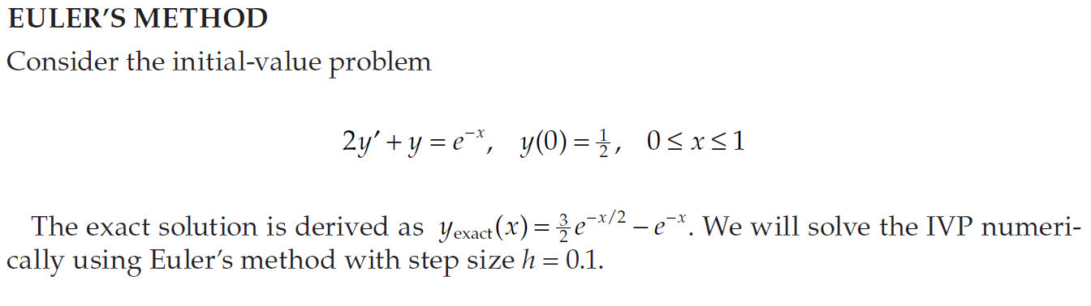
Exercise:
Using Matlab, compare the numerical solution for different h=0.1 and h=0.05

Slide 39
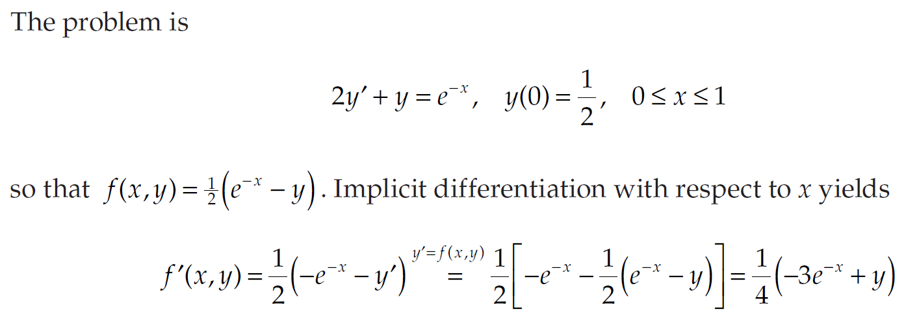
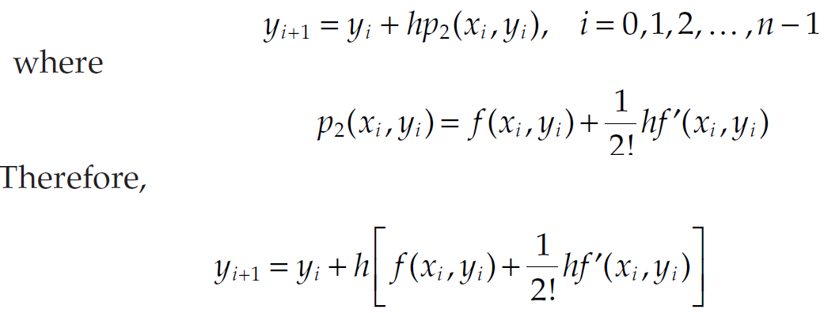
EXERCISE: SECOND-ORDER TAYLOR METHOD
SECOND-ORDER TAYLOR METHOD
Solve the initial-value problem in Example before using the second-order Taylor method with the same step size h = 0.1 as before and compare the numerical results with those produced by Euler’s method.

